Slide 1
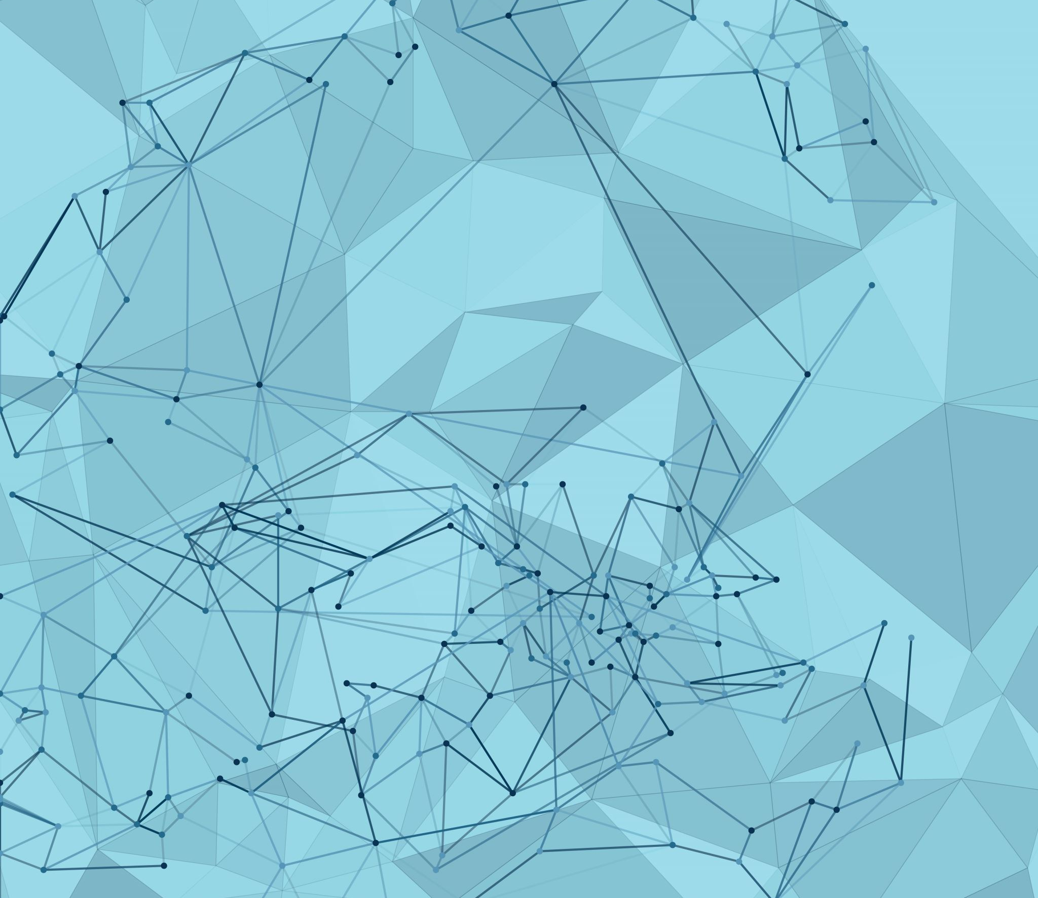
COMBI-TAGGER: A U.I. FOR ALPHAFOLD EVALUATION OF RECOMBINANT TAG INDUCED CONFORMATIONAL SHIFTING
CHRIS KONG & HENRY SCOTT
BP219: FALL 2022
Notes:
Consider changing title slide to something that incorporates output structures?

Slide 2






Problem: protein affinity/fusion tags…necessary- but can represent blackboxes
How do I choose the right tag?
I picked the right tag and have my construct design!
Purification and Experimentation
Where’d my protein go!?
Why is my protein acting so abnormally ???
Solution: Uni-Tagger

Slide 3

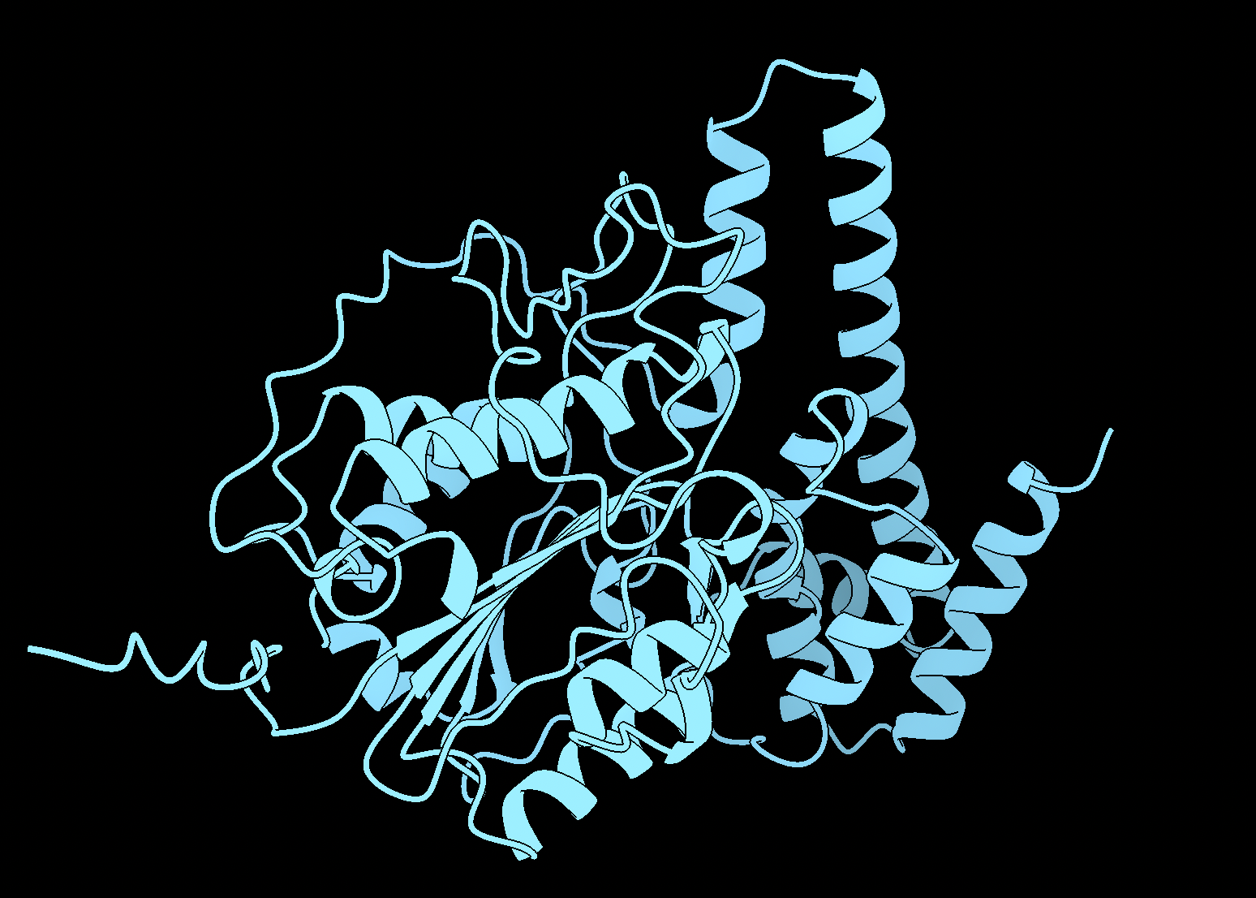
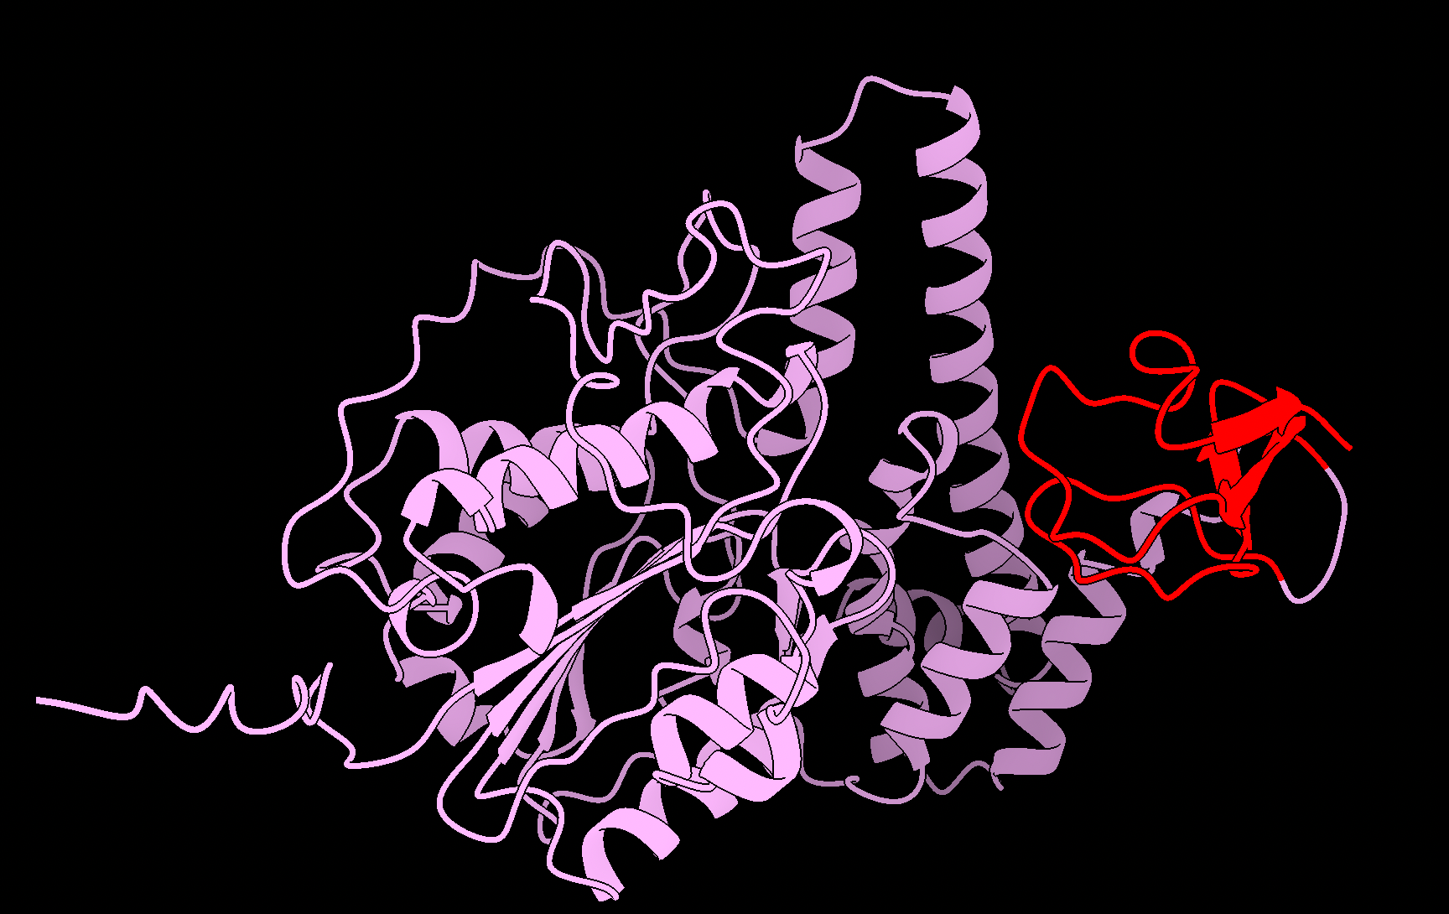
Uni-Tagger: A UI for evaluation of conformational changes to native structure induced by the
introduction of a recombinant tag or fusion protein.
Protein
Protein-tag
&
base operation
Functionality
Where:
Alphafold2
structure prediction
= native protein
Parallel evaluation of multiple tags
UI grad.io
= tags
Parallel evaluation of multiple proteins
Rigid-body alignment of resultant structure predictions
Biopython
RMSD measurement of aligned protein vs protein-tag
output
aligned .pdb coordinates
graph(s) of global RMSD values
Notes:
Logic: By comparing structure predictions of native protein Vs. protein-tag maybe we can spot probable

Slide 4
Start of cbat’s slides

